Slide 1
Tower Hamlets Together
Integrated Care Awards 2023
7th December 2023 hosted by The Tower Hamlets Together Partners
www.towerhamletstogether.com #TH2GETHER

Slide 2
Housekeeping
This event will be recorded
Cameras are encouraged
Please mute your mics
Using emojis and gifs are encouraged
Using the chat function is encouraged
Wearing something sparkly is encouraged

Slide 3
Sequence of Events
13:45 Introduction message from Amy Gibbs – Tower Hamlets Together Independent Chair
14:00 Tower Hamlets Together Quiz
14:15 The main event – Presenting Tower Hamlets Together Staff Integrated Care Awards
14:50 Closing message

Slide 4
Introduction from Amy Gibbs
Tower Hamlets Together Independent Chair

Slide 5
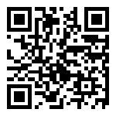
Tower Hamlets Together
QUIZ
Scan the QR code below..
Or..
Join at
slido.com
#1755192
https://www.towerhamlets.is/

Slide 6
THE MAIN EVENT
Notes:
No comments

Slide 7
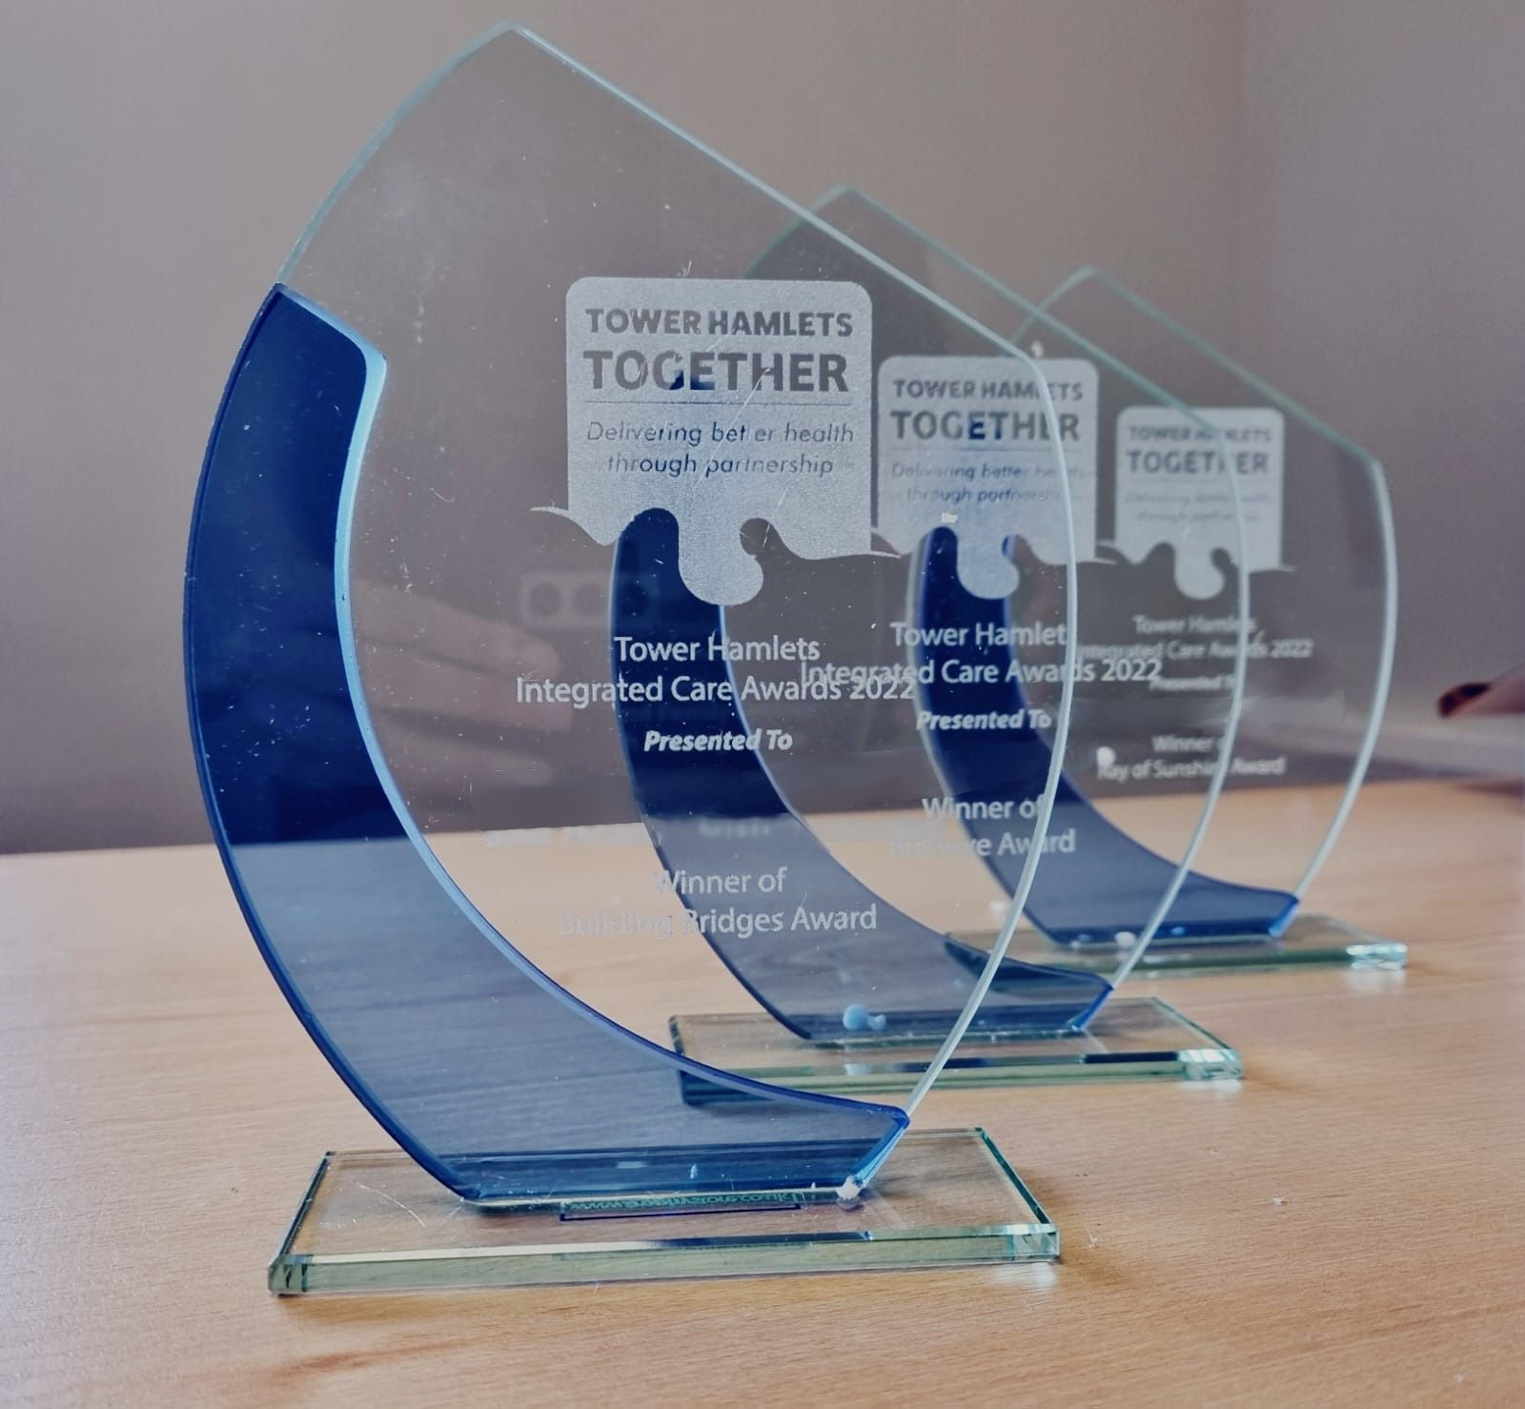
Nominees, Highly Commended & Winners
Tower Hamlets Together are pleased to announce that Highly Commended & Winners will all receive a personalised award – either as an individual or a service/team. In addition, Winners will also receive
Love2Shop Vouchers.
All Nominees will receive certificates.
The THT Team will contact you separately to discuss delivery of these!

Slide 8
Nominees for
Shape Shifter Award are..
Adam Pervoe - Nominated by Lorna Francis
Admission Avoidance and Discharge Service - Nominated by Eleanor Mata
Adult Social Care - Nominated by Katie O'Driscoll
Anne Page - Nominated by Katie O’Driscoll
Auzufa Choudhury - Nominated by Nilufa Yasmin
Ayfiya Begum Samad - Nominated by Urmee Maryam Kaddir Rabbani
Firdoshe Begum - Nominated by Graeme Miller
Francesca Caruana - Nominated by Afzal Ahmed
Globe Court Care Home - Nominated by Jeanette Ponton
Nonsi Mabhena and Rebecca Taylor - Nominated by Justin Wakefield
Tower Hamlets Reablement Service - Nominated by Anastasia Boulis
Saleha Uddin - Nominated by Rajkumari Peck
ROUND OF APPLAUSE FOR ALL OF OUR 12 ‘SHAPE SHIFTER AWARD’ NOMINEES!

Slide 9
Joint Highly Commended for
Shape Shifter Award goes to..
Nonsi Mabhena & Rebecca Taylor
Tower Hamlets CAMHS
Nominator Justin Wakefield’s comments include.. “Nonsi and Rebecca have set up a really well received waiting list intervention for the parents of young people on our Attention deficit hyperactivity disorder (ADHD) waiting list.”
…“In the face of a real shift of focus and increasing awareness of ADHD, Nonsi and Rebecca have developed and delivered an intervention for parents that is really making a difference, parents are giving excellent feedback for and is developing relationships across the borough..”
CONGRATULTIONS TO BOTH!

Slide 10
Joint Winners for Shape Shifter Award goes to..
Auzufa Choudhury, Ayfiya Begum Samad & Saleha Uddin
GP Care Group
Nominator Rajkumari Peck’s comments include.. “Saleha is very flexible and she is very reliable and goes the extra mile for the parents/guardians for our service She listens and communicates well with people so that they feel their needs are heard and understood. Thank you Saleha for your consistent hard work and dedication to the Paediatric Continence Service.”
Nominator Nilufa Yasmin’s comments include.. “Auzufa has been in Advocacy for 14 years+ and is excellent at her job, she is very hardworking, fast and efficient. She deals with any queries promptly and makes sure that the service is running smoothly. I believe Auzufa is an asset to our team.”
Nominator Urmee Maryam Kaddir Rabbani’s comments include.. “Ayfiya has worked in Tower Hamlets for 30 years she has worked with multidisciplinary teams at present working with THGPCG Advocacy service . She is a good team player and she is willing to go an extra mile to help / flexible when needed to be in her role to accommodate..”
A FEW WORDS FROM THE WINNERS?

Slide 11
The Creative Wizard Award
Creativity and Innovation
This is for teams and individuals who have shown particular creativity and innovation in developing
new ideas to meet the changing needs of a population or workforce over the past year.

Slide 12
Nominees for
Creative Wizard Award are..
Admission Avoidance and Discharge Service – Nominated by Eleanor Mata
Angela Burns – Nominated by Liam Crosby
Ashadul Alom – Nominated by Afzal Ahmed
Eleasar Reas – Nominated by Giannoula Tzanoukaki
Maryam Rouf – Nominated by Katie O'Driscoll
Mutiur Rahman – Nominated by Shruthi Ravi
The GP Care Group Open Doors Nursing Development service – Nominated by Vicky Scarborough & Ekramul Hoque
The Team of Health E1 Homeless Medical Centre – Nominated by Amin Islam
Urgent Community Response (Rapid Response) Team – Nominated by Georgina Birch
ROUND OF APPLAUSE FOR ALL OF OUR 9 ‘CREATIVE WIZARD AWARD’ NOMINEES!

Slide 13
Joint Highly Commended for
Creative Wizard Award goes to..
Admission Avoidance & Discharge Service - ELFT
and Maryam Rouf - LBTH
Nominator Eleanor Mata’s comments include.. “The primary focus of ELFT Admission Avoidance & Discharge Service is to provide therapy input to those patients in the Emergency Department (ED) who are planned for discharge within 0-24hours. From Jan to March 2023, there were 126 patients who avoided admission from ED saving £56,700 bed days cost.
Nominator Katie O’Driscoll’s comments include.. “Maryam has developed the Shared Lives Service in Tower Hamlets from scratch. She has provided such dedication to the service and role and is making a real difference to people's lives. She is one of our social care heroes!”
CONGRATULTIONS TO BOTH!

Slide 14
Joint Winners for Creative Wizard Award goes to..
Angela Burns - LBTH
and The Open Doors Nursing Development Service
– GP Care Group
Nominator Liam Crosby’s comments include.. “Angela's unwavering commitment to creative problem-solving, innovative thinking, and her resourceful partnership approach make her a truly deserving candidate for this recognition. Angela demonstrates THT Leadership values through her work. In particular she is curious, she meaningfully shares power and through doing so, works with partners creatively to develop shared purpose. A real Creative Wizard! ”
Nominators Vicky Scarborough & Ekramul Hoque’s comments include.. “..to date, 81 Practice Nurses have been recruited through the programme, with retention rates consistently excellent at over 95% 3 years post training. The outstanding efforts and outcomes achieved through the Open Doors team have not only strengthened our primary care system but have also contributed significantly to the overall improvement in patient care and satisfaction.”
A FEW WORDS FROM THE WINNERS?

Slide 15
The Building Bridges Award
Partnership Working
This award is for teams and individuals who have been able to work collaboratively across services and organisations to meet changing needs of the population or workforce.

Slide 16
Nominees for
Building Bridges Award are..
Adam Pervoe – Nominated by Akbal Ahmed
Admission Avoidance and Discharge Service – Nominated by Eleanor Mata
Continence Service – Nominated by Chinny Ejiogu
Emma Robinson – Nominated by Petra Nittel
Ghyama Arts! – Nominated by Yousuf Peshavaria
James Dodd and Suzy Laird – Nominated by Joanna Conroy
Jon Williams – Nominated by Jenny Rush
Quality and Audit Assurance Team – Nominated by Graeme Miller
Samuel Echagaray – Nominated by Daniel Gibney
The Children's Atopy Team – Nominated by Laura King
The Hospital Social Work Team – Nominated by Rosa Garrido
The Primary Care Advocacy Team – Nominated by Liz Hands
Werdi Adan – Nominated by Coffee Afrique
A ROUND OF APPLAUSE FOR 13 ‘BUILDING BRIDGES AWARD’ NOMINEES!

Slide 17
Joint Highly Commended for
Building Bridges Award goes to..
Samuel Echagaray & Jon Williams
NEL ICB
Nominator Jenny Rush’s comments include.. “Jon is proactively facilitating the development of a shared approach to co-production across the THT partnership. His great dedication to transparency, integrated working and inclusiveness shines through in this work. He builds great relationships with people and teams across the partnership, effectively acting as an agent for deeper partnership working, and a more integrated approach that reduces duplication and helping to prepare the partnership for working in a hyper local and neighbourhood way”
Nominator Daniel Gibney’s comments include.. “Sam has been supporting the work across the borough for our refugees and asylum seekers (mainly those in temporary accommodation). Sam has worked tirelessly and passionately in supporting the multiple health improvement workstreams and projects for this cohort of patients over the last year. Sam supported local practices in our challenges with provision but in also supporting the wider multi-agency and challenging systems wide issues which he has helped us navigate.”
CONGRATULTIONS TO BOTH!

Slide 18
Joint Winners for Building Bridges Award goes to..
Adam Pervoe Age UK East London
& Ghyama Arts!
Nominator Yousuf Peshavaria’s comments include.. “The Ghyama Arts is a partnership between Bangladeshi Parents and Carers Association (BPCA) and St. Margaret's House. It has excelled in the past three years by fostering collaborations across services and organisations to enhance integrated care in the local community. It stands out as an exemplar of successful partnership working, all organisations involved have shown dedication to collaboration, overcoming obstacles, and optimizing integrated care processes which has led to tangible improvements in addressing the evolving needs of our community.
Nominator Akbal Ahmed’s comments include.. “Adam has been fantastic in mobilising a new service which delivers early help, intervention, advice and advocacy across the borough. He has led a new service and put together a new team to deliver positive outcomes for residents. He has done this by excellent partnership work across the THT partners.”
Nominator Larissa Howells comments include..
“Adam has been central to the development of the Tower Hamlets Connect partnership since its inception in July 2021. This service has represented a new way of working across sectors in Tower Hamlets”
A FEW WORDS FROM THE WINNERS?

Slide 19
The Bullseye Award
Person-centred care
This award is for teams or individuals who have ensured that
the well-being and needs of service users or employees is at
the heart of service delivery in spite of changing circumstances.

Slide 20
Nominees for Bullseye Award are..
Abisola Adejinmi - Nominated by Ozemoya Peter Momoh
Ade Akande - Nominated by Treaser Jassal
Alison Walsh - Nominated by Deborah Cordrey
Bromley by Bow Centre - Social Care Team - Nominated by Clare Kelly
Deborah McDonald - Nominated by Mohammed Sahed Hussain
Dr Arunan Jothieswaran - Nominated by Syeda Tashin
Health E1 GP Surgery - Nominated by Laura Pisaneschi
Independent Living Hub - Katie Dove and Iftekhar Lais - Nominated by Alex Hadayah
Kamal Hussain - Nominated by Shabanaz Begum
Reablement Service - Nominated by Anastasia Boulis
Russia Lane Day Centre - Nominated by Nurjahan Julie Begum
TH EPCT Care Navigation Service - Nominated by Fran Colley
Tyrone Josephine, Primary Care Network 6 - Nominated by Natasha Sutton
ROUND OF APPLAUSE FOR ALL OF OUR 13 ‘BULLSEYE AWARD’ NOMINEES!

Slide 21
Joint Highly Commended for Bullseye Award goes to..
Nominator Nurjahan Julie Begum’s comments include.. “The Russia Lane Day Centre provides care, support and stimulation for up to 25 people with moderate to severe dementia..”
Nominator Alex Hadayah’s comments include..
“The Independent Living Hub is creatively assessing residents in its bathing clinic - the assessments mean that residents get an assessment and trial of multiple pieces of equipment in one setting of the adapted house in Tower Hamlets..”
Russia Lane Day Centre & The Independent Living Hub
LBTH
“The person when trying the equipment is involved in trying each piece of equipment and can make an informed decision and see the equipment. This is really key to successful support and maintaining and independent life at home as the person will have been listened to during the assessment and trial demonstrating a person centred approach. .”
“..It meets the individual needs of our users.
Helps people maintain their independence, whilst offering support to carers.
Offers social interaction with others and provides an opportunity to make new friends.
Achieves a stimulating environment with a variety of activities. Creates a lively and friendly atmosphere, where all are made to feel welcome.”
CONGRATULTIONS TO BOTH!

Slide 22
Joint Winners for Bullseye Award goes to..
Nominator Treaser Jassal’s comments include.. “Ade is an inspirational person and is someone who puts young people first in all that he does. He focuses on a person-centered approach, working with the young people
and their families to support them
with coaching, advice and
engagement with relevant services.”
Nominator Laura Pisaneschi’s comments include.. “The team at Health E1 is a specialist practice for homeless individuals who are often stigmatised by lots of services due to their housing situation. They recently hosted a summer fair with a collaborative effort
with numerous local services.”
“..The aim was to provide a holistic and comprehensive healthcare experience to the community. The event was unique in its approach, being patient-led rather than practice-led. The team has a relentless commitment to empower our patients and ensure equitable access to healthcare for all, especially those facing social or economic barriers.”
Ade Akande – Spotlight
& Health E1 GP Surgery
“..He works with young people not only on their physical health needs but with their social and emotional needs, supporting them to access activities and achieve their set goals. He does this through relationship and trust building, making the young person feel comfortable to open up.”
A FEW WORDS FROM THE WINNERS?

Slide 23
The Visionary Award Collaborative Leadership
This award is for teams or individuals who have worked collaboratively to ensure teams services have a shared vision to address changing needs in integrated care.

Slide 24
Nominees for The Visionary Award are..
Adult Social Care and Integrated Commissioning Management Team - Nominated by Katie O'Driscoll
Dr Spyridon Symniakou - Nominated by Afzal Ahmed
Ekramul Hoque - Nominated by Sophie Dissanayake
Francesca Howes - Komal Whittaker-Axon
Katie O'Driscoll - Denise Radley
Mrs Claire Hern - Nominated by Pamela Allanson
Shilpa Shah – Dalv eer Singh Johal
Stef Abrar - Nominated by Natalia Clifford
ROUND OF APPLAUSE FOR OUR 8 ‘VISIONARY AWARD’ NOMINEES!

Slide 25
Joint Highly Commended for Visionary Award goes to..
Nominator Natalia Clifford’s comments include..
“Stef is a shining light in collaborative leadership in integrated care, unifying diverse teams and individuals to work in harmony towards a shared vision of addressing inequalities and meeting resident's needs. Stef's journey is marked by an unwavering commitment to inclusivity and an insatiable drive for excellence.”
Steph Abrar - LBTH &
Shilpa Shah - Community Pharmacy NEL
Nominator Dalveer Singh Johal’s comments include..
“Shilpa has worked tirelessly across multiple sectors and organisations to ensure that the community pharmacy offering has always been at the forefront of discussions relating to the health of local residents. She has innovated and developed services which are specific to the needs of the local population.”
CONGRATULTIONS TO BOTH!

Slide 26
Joint Winners for Visionary Award goes to..
Nominator Denise Radley’s comments include..
“Katie leads with clarity of vision and purpose and a collaborative approach to all she does. Katie's leadership has delivered huge improvements in staff recruitment and retention supported by an excellent learning and development offer. Katie is open and transparent and brings people together to address concerns and focus on improvement”
Nominator Sophie Dissanayake’s comments include..
“Ekramul brings passion, innovation and energy to all projects however large or small, which is truly infectious. Through his leadership, many projects which he helped initiate in Tower Hamlets such as Suicide Prevention, have started to be recognised on a national and international level, which really raises the profile of Tower Hamlets as a creative and forward thinking borough.”
Katie O’Driscoll - LBTH & Ekramul Hoque - GP Care Group
A FEW WORDS FROM THE WINNERS?

Slide 27
The Ray of Sunshine Award
Recognition & Celebration
This award is for teams or individuals who have helped create an atmosphere of appreciation and recognition of the strengths and assets of others.

Slide 28
Nominees for The Ray of Sunshine Award are..
Age UK based at The Royal London Hospital/Bart's Health - Nominated by Coral Knight
Anthony Allnatt - Nominated by Alii Chattaroo
Carola Stefan - Nominated by Justin Wakefield
Dr Eleni Besi - Nominated by Mario Gargiulo
Eucharia Ofoegbu - Nominated by Tania Aguiar-Bouanimba
Husneara Ali - Nominated by Sabir Ahmed
Kat Sturgeon - Nominated by Yasmin Begum
Mayur Choudhary, Hardeep Kaur, Plinio Hollywood, Vansh Ratti - Nominated by Jeanette Ponton
Natasha Sutton - Nominated by Darren Ingram
Practice Development Team - Nominated by Katie O'Driscoll
Tower Hamlets Carers Centre + Commissioners - Shuheda Uddin & Jamie Bird - Nominated by Denise Radley
A ROUND OF APPLAUSE FOR OUR 11 ‘RAY OF SUNSHINE’ NOMINEES!

Slide 29
Highly Commended for Ray of Sunshine Award goes to..
Nominator Denise Radley’s comments include..
“Tower Hamlets Carers Centre provide a range of great services for carers and make a strong contribution to partnership working including being active members of the Promoting Independence Workstream and recently, presenting at the Tower Hamlets Together Board .”
Tower Hamlets Carers Centre + LBTH Commissioners - Shuheda Uddin & Jamie Bird
Tower Hamlets Carers Centre are commissioned by Shuheda and Jamie who provide a consistent focus on carers within the Council, achieving Carers Confident status, maintaining a high profile with Carers UK and supporting staff networks.
CONGRATULTIONS TO ALL!

Slide 30
Joint Winners for Ray of Sunshine Award goes to..
Nominator Jeanette Ponton’s comments include.. “These four members of staff are brave and courageous and continue to work with us even though this must have been a very difficult time for all of them..”
“..They have shown just how much they care about their job role and how much they care about residents and other members of staff.”
Nominator Jeanette Ponton’s comments include.. “I would like to nominate these 4 individuals for their professionalism during an unexpected suicide at Globe Court Care Home in March this year.”
Mayur Choudhary
Hardeep Kaur
Plinio Hollywood
Vansh Ratti
Globe Court Care Home
“…The Police Officer commended my staff and said how professional they all were under very difficult circumstances.”
“..I feel these 4 members of staff should be honoured with an award as they kept all other residents safe and continued to do so until their shift had ended..”
A FEW WORDS FROM THE WINNERS?

Slide 31
THT Staff Integrated Care Awards 2023
Thank you to all of those who nominated individuals, teams and services.
Thank you to everyone who joined the event today to celebrate..
Tower Hamlets Together

Slide 32
Closing message from our hosts…
WELLBEING
https://keepingwellnel.nhs.uk/
Let’s celebrate!
www.towerhamletstogether.com #TH2GETHER

